Slide 1

<number>

Slide 2
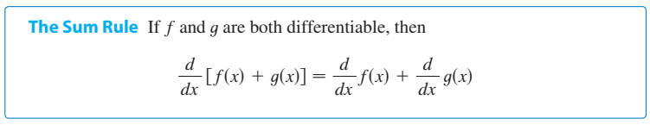

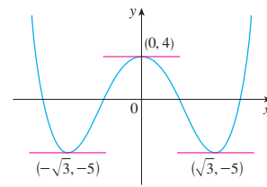
<number>

Slide 3
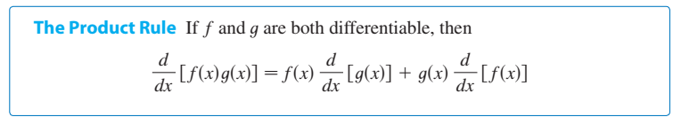
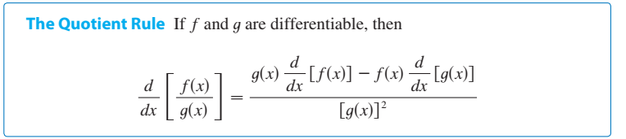
<number>

Slide 4

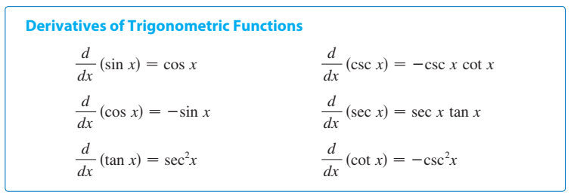
<number>

Slide 5
<number>

Slide 6
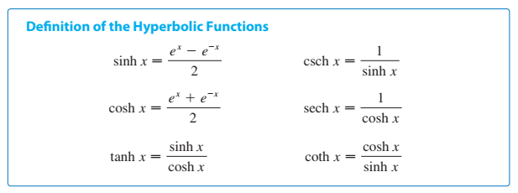
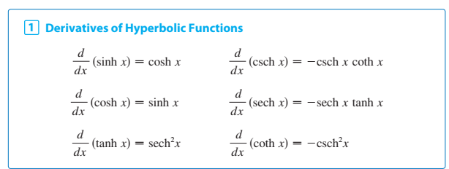
<number>

Slide 7
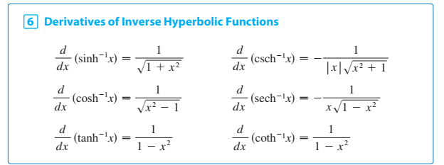
<number>

Slide 8
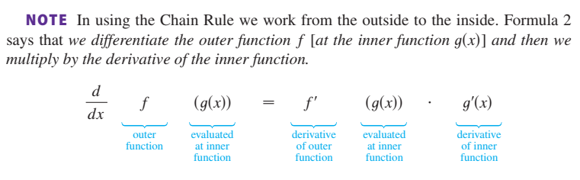
<number>

Slide 9
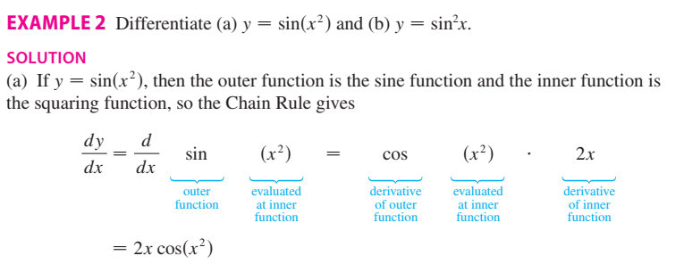
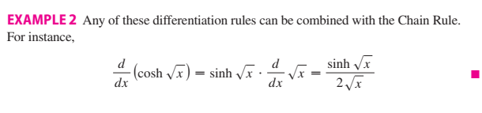
<number>

Slide 10
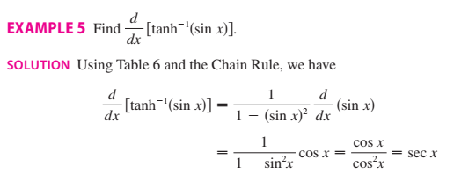
<number>

Slide 11

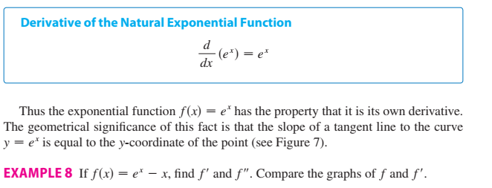
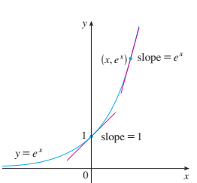
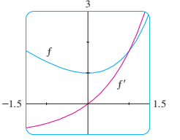

<number>

Slide 12

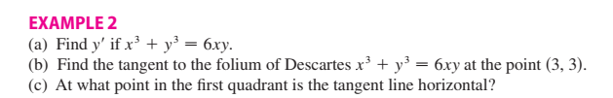
Explicit and implicit functions
The function is an explicit function if we can expressed one variable explicitly in term of another variable,
If not then the function is known as an implicit function for examples
$y=xsinx$
$y=\sqrt{x^{2}+1}$
Explicit functions
Implicit functions
$x^{3}+y^{3}=6xy$
<number>

Slide 13




<number>

Slide 14
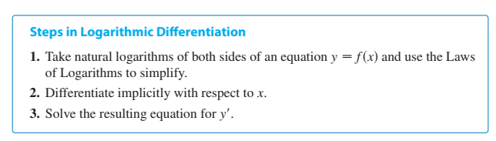


<number>

Slide 15



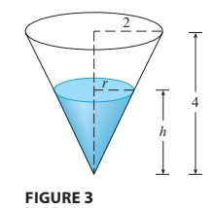
<number>

Slide 16

<number>

Slide 17
<number>

Slide 18
<number>

Slide 19
<number>

Slide 20
<number>

Slide 21
<number>

Slide 22
<number>

Slide 23
<number>

Slide 24
<number>

Slide 25
<number>

Slide 26
The End
<number>

